Slide 1

Communication
Distributed
Systems
CPSC 5520
Kevin Lundeen

Slide 2
Processes
Threads
Virtualization
Clients
Servers

Slide 3
Threads
Threads use shared-memory for communication
  Locks are used to limit critical-section access to shared data structures
Threads are commonly used in client/server architectures
Client
  Hiding network latency – asynchronous I/O
    If multiple server conversations, can provide linear speed-up
  Example: web browser
    Browser scans an incoming HTML page, finds that more files need to be fetched
    Each file is fetched on a separate thread, each doing a blocking HTTP request
    As files come into each of the threads, the browser displays them
Server
  Starts a new thread for every new incoming connection
  So, like multi-threaded clients, hides network latency
    Each thread uses easy-to-program blocking I/O

Slide 4
Virtualization
Virtualization is important in deployment
  Hardware changes faster than software
  Ease of portability and code migration
  Isolation of failing or attacked components
  (more on this in Week 9)

Slide 5
Client-Side Software
Generally tailored for distribution transparency
  Access transparency: client-side stubs for RPCs
  Location/migration transparency: let client-side software keep track of actual location
  Replication transparency: multiple invocations handled by client stub
  Failure transparency: can often be placed only at client (we’re trying to mask server and communication failures)

Slide 6
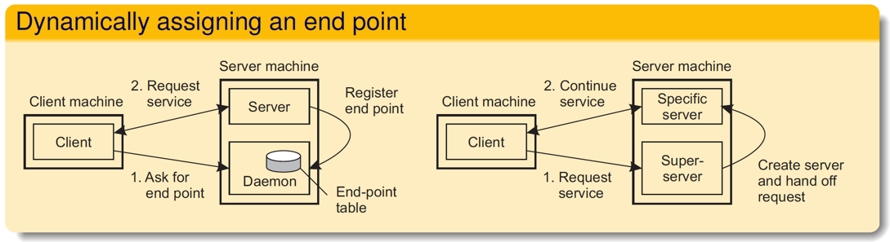
Servers
Basic model
  A process implementing a specific service on behalf of a collection of clients. It waits for an incoming request from a client and subsequently ensures that the request is taken care of, after which it waits for the next incoming request.
Request-handling strategies:
  Iterative server
  Concurrent server (the norm)
Contacting a server
  Usually with IP: so requires a host address (IPv4 or IPv6)
  Usually TCP/IP or UDP/IP: so requires a port number

Slide 7
Server Clusters
Transport-layer switching:
  Front end simply passes the TCP request to one of the servers, taking some performance metric into account.
Content-aware distribution:
  Front end reads the content of the request and then selects the best server
Combining solutions:

Slide 8
Distributed Servers
This is where a service is served by multiple nodes distributed around the world
  Using DNS, for example:
    Client looks up specific service through DNS - client’s IP address is part of request
    DNS server keeps track of replica servers for the requested service, and returns address of most local server
    Problem is that the resolver may actually be far from local to the actual client
Using Mobil IPv6
  Client C sets up connection to IPv6 home address HA
  HA is maintained by a (network-level) home agent, which hands off the connection to a registered care-of address CA
  C can then apply route optimization by directly forwarding packets to address CA (i.e., without the handoff through the home agent).

Slide 9
Communication
IPC
RPC/RMI
Messages
Multicast

Slide 10
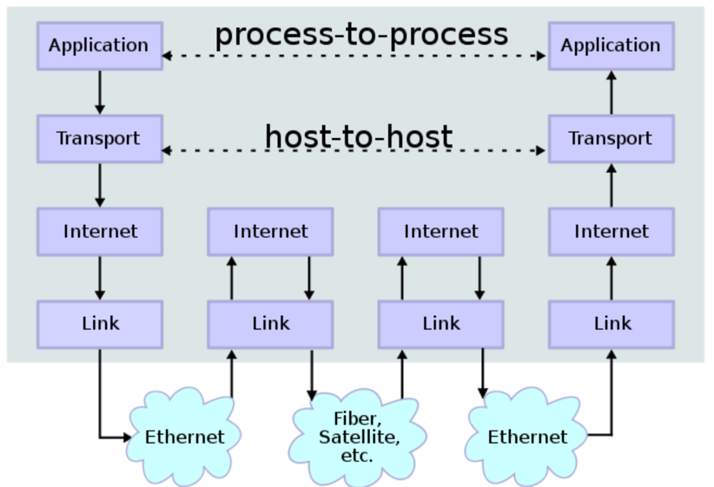
Inter-process Communication (IPC) Protocols
Message-based systems (as opposed to shared-memory systems) send messages for communication across a network
  Tightly-coupled systems may use ethernet or bus-based protocols
    MPI is a common interface
  But most distributed systems use IP
    TCP/IP
    UDP/IP
By en:User:Kbrose - Prior Wikipedia artwork by en:User:Cburnett, CC BY-SA 3.0, https://commons.wikimedia.org/w/index.php?curid=1831900

Slide 11

Internet Protocol Suite
Link Layer
  Ethernet, wifi, etc.
  Think physical MAC address on a machine
Internet Layer
  Corresponds roughly to network layer in OSI stack
  Think host-to-host
Transport Layer
  Mostly TCP and UDP
  Think host/port-to-host/port
Application Layer
  Think program-to-program; how to interpret the bits in the socket recv
  Examples: DNS, SSH, HTTP

Slide 12
Internet Layer:
Internet Protocol (IP)
End-to-end communication based on host IP address
IPv4
  in use by 1983
  pseudo-hierarchical 32-bit host address (e.g., 172.217.3.174)
IPv6
  in use concurrently with IPv4 (first proposed 1998)
  pseudo-hierarchical 128-bit host address (e.g. 2001:db8::ff00:42:8329)
  better multicasting
  better mobility (MobileIPv6)

Slide 13
Transport Layer
Transport layer adds a port number to the internet address
Simplest is UDP
  datagram – whole message is delivered (or not at all)
  connectionless – no handshaking messages
  unreliable (best-effort only)
    not guaranteed
    not ordered
    may be delivered zero, one, or more times
  has integrity via checksum
  used by DNS, DHCP
Most common is TCP
  stream based – no delineation between messages
  connection is established (three packet overhead)
  reliable
    some guarantees
    ordered
    delivered once (but may be severely delayed to fulfill guarantees and handle congestion)
  used by SSH, HTTP (newest HTTP uses UDP), HTTPS

Slide 14
RPC
1984, Birrell & Nelson
  Mechanism to call procedures on other machines
Goal:
  It should appear to the programmer that a conventional (local) call is taking place

Slide 15
Implementing RPC
The trick:
  Create stub functions to make it appear to the user that the call is local
On the client
  The stub function has the function’s interface
  Packages parameters and calls the server
On the server
  The stub function (skeleton) receives the request and calls the local function

Slide 16
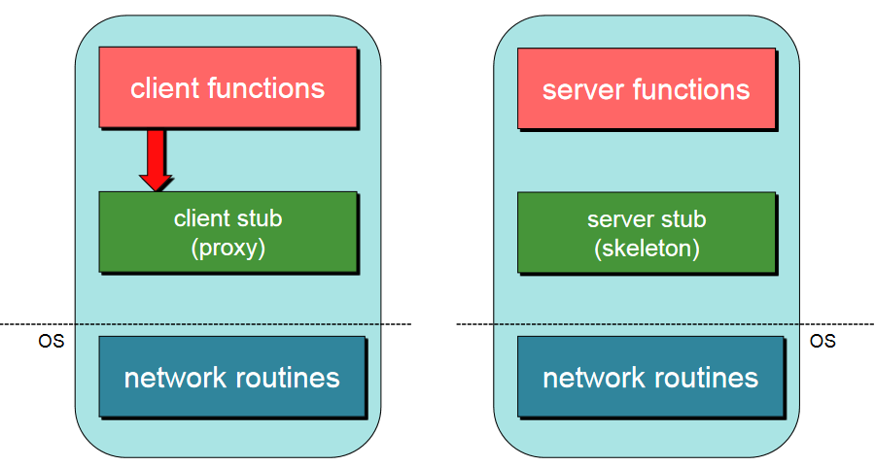
1. Client calls stub (params on stack)

Slide 17
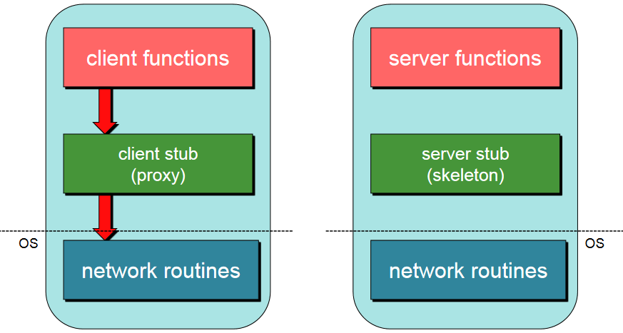
2. Stub marshals params to net message
Marshalling = put parameters in a form suitable for transmission over a network (serialized)

Slide 18
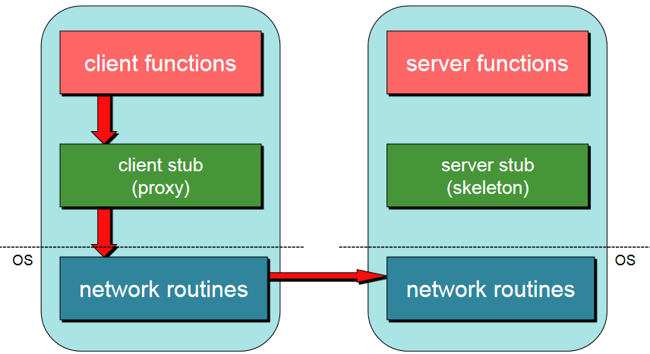
3. Network message sent over to the server

Slide 19
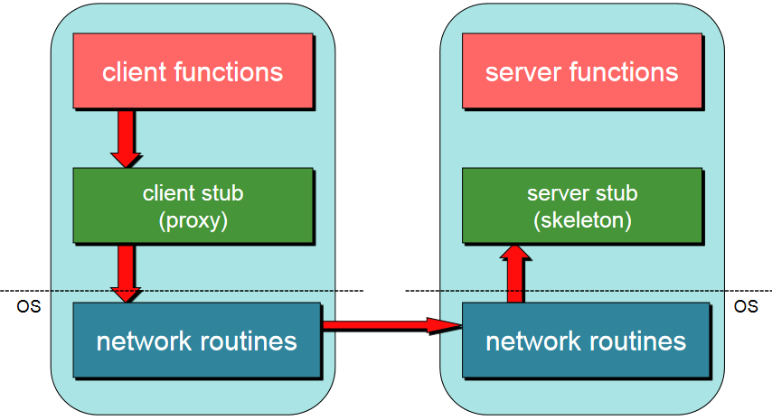
4. Receive message: send it to server stub

Slide 20
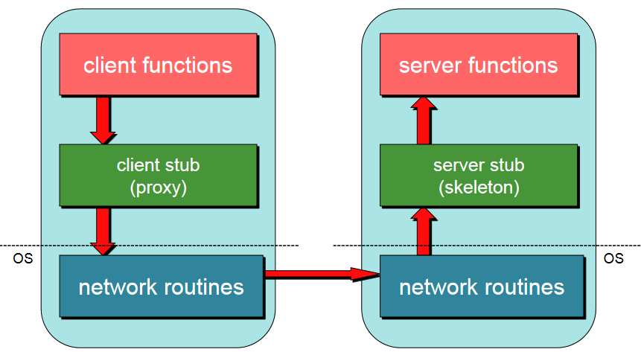
5. Unmarshals parameters, call server function

Slide 21
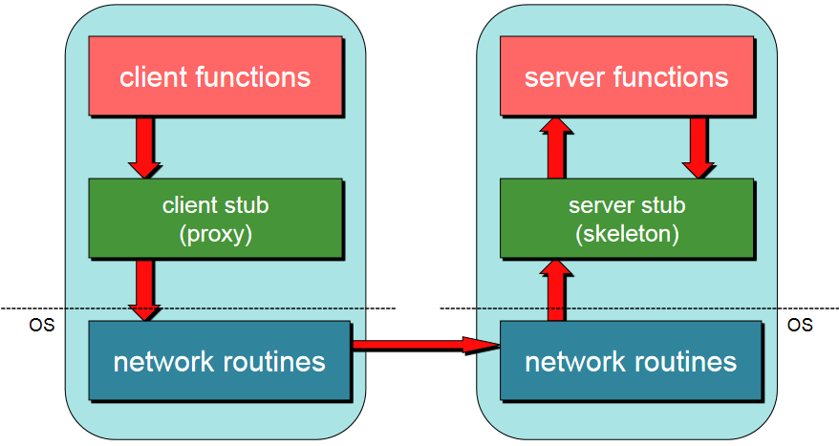
6. Return from server function

Slide 22
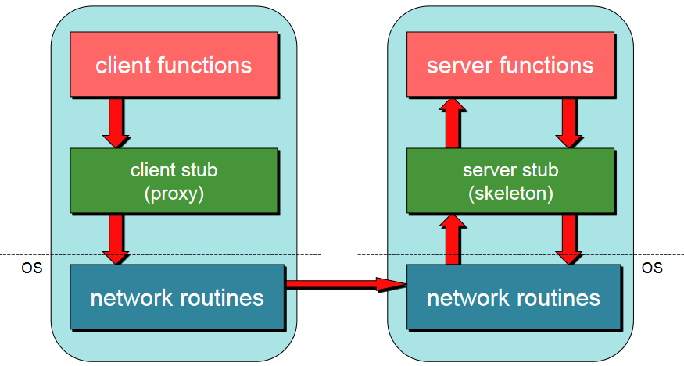
7. Marshal return value and send message

Slide 23
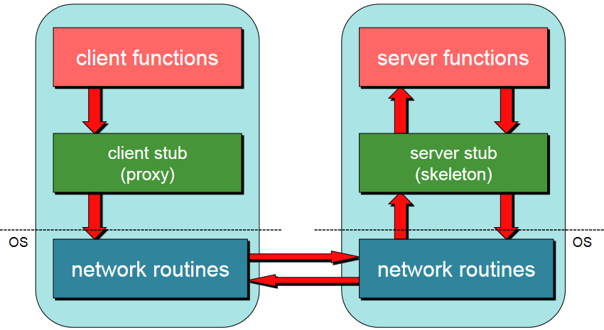
8. Transfer message over the network

Slide 24
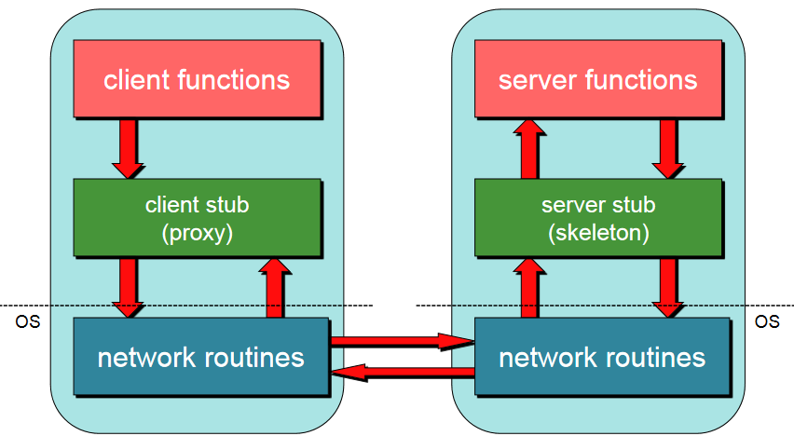
9. Client stub receives message

Slide 25
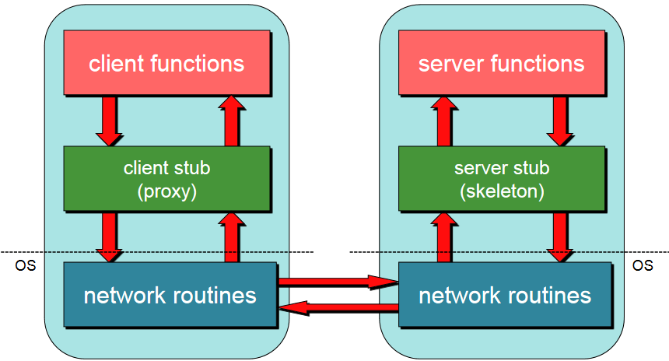
10. Unmarshal return value(s), return to client code

Slide 26
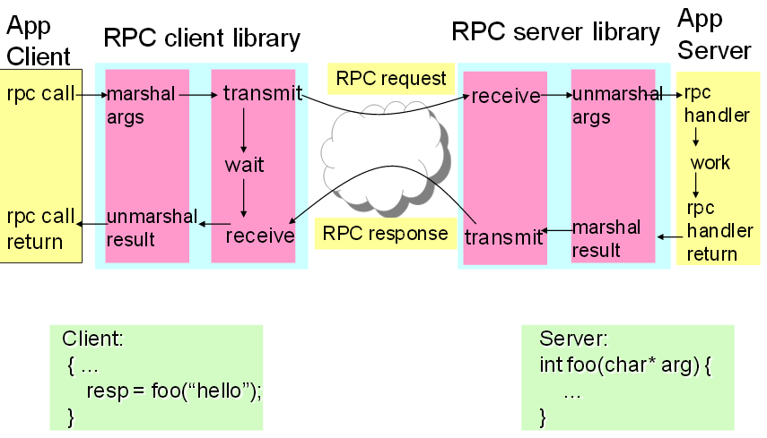
RPC Overview

Slide 27
RPC API
What kind of services does a RPC system need?
Interface Definition Language (IDL)
Name service operations
  Export/lookup binding info. (ports, machines)
  Support dynamic ports
Binding operations
  Establishing c/s communication using appropriate protocol (establish endpoints)
Endpoint operations
  Listen for requests, export endpoint to name server
Security operations
  Authenticate client/server
Marshaling/Data conversion operations
  Binary formats
  XML or JSON
  Pass by reference
Stub memory management
  Dealing with “reference” data, temporary buffers
Versioning
  Allow applications to access IDs of RPC interfaces, etc.

Slide 28

Sending data over the network

Slide 29
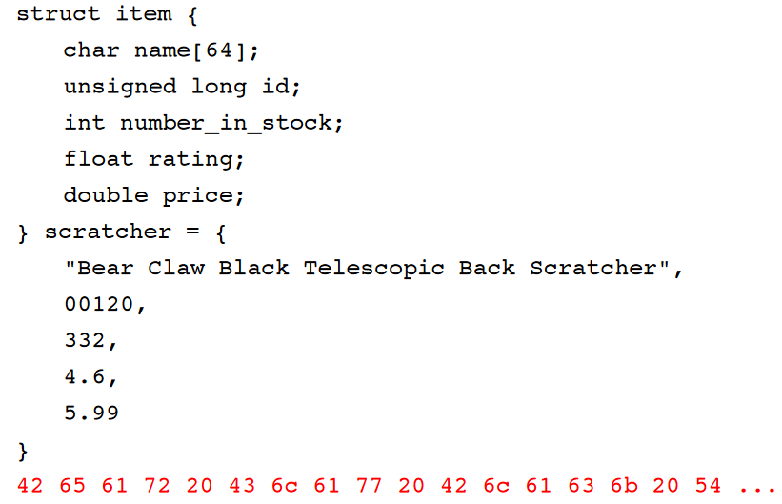
We need a stream of bytes

Slide 30
Representing Data
On local system: no incompatibility problems
Remote machine may have
  Different byte ordering
  Different sizes of integers and other types
  Different float point representations
  Different character sets
  Alignment requirement

Slide 31
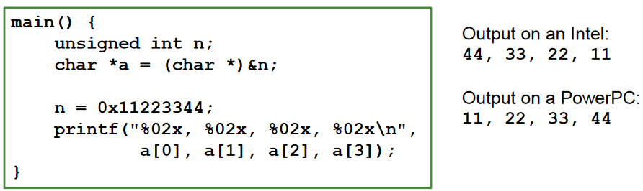
Representing Data
IP (headers) forced all to use big endian byte order for 16- and 32-bit values
Big endian: Most significant byte in low memory
─ SPARC < V9, Motorola 680x0, older PowerPC
Little endian: Most significant byte in high memory
─ Intel/AMD IA-32, x64
Bi-endian: Processor may operate in either mode
─ ARM, PowerPC, MIPS, SPARC V9, IA-64(Intel Itanium)

Slide 32
Representing Data: Serialization
Need standard encoding to enable communication between heterogeneous systems
Serialization
  Convert data into a pointerless format: an array of bytes
Examples
  XDR (eXternal Data Representation), used by ONC RPC
  JSON (JavaScript Object Notation)
  W3C XML Schema Language
  ASN.1 (ISO Abstract Syntax Notation)
  Google Protocol Buffers
  Python pickling

Slide 33
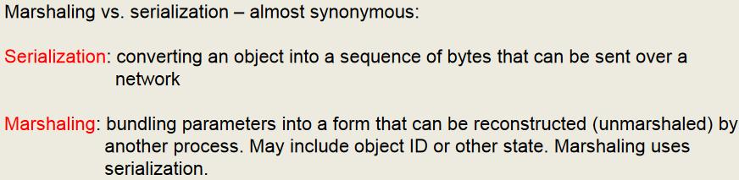
Serializing Data
Implicit typing
  Only values are transmitted, no data types or parameter info
  E.g., ONC XDR (RFC 4506)
Explicit typing
  Type is transmitted with each value
  E.g., ISO’s ASN.1, XML, protocol buffers, JSON

Slide 34
RMI
Remote Method Invocation
  Like RPC but with reference to a remote or distributed object
Common Mechanisms:
  Corba
  DCOM
  SOAP
Example: Simple Object Access Protocol (SOAP)
  1999
  Call and return over HTTP or HTTPS
    can also use SMTP
    endpoints are managed via internet URI’s
  Marshalling is via XML
  IDL is also XML
    wsdl file at a separate URI

Slide 35

The End of Communication

